Slide 1

Data Mining for Fraud Detection
Ismayil Aliyev
ST88541
Data Analytics and Artificial Intelligence
Data Mining

Slide 2
Outline
Introduction
Goals
Relevance
Tools & Libraries Used
Understanding the Data and Preparation
Random Under sampling and Over sampling
Model Building and Evaluation
Conclusion
References
Ismayil Aliyev

Slide 3

Introduction
Introduction
Fraud is a growing issue in many industries, especially in areas like banking and e-commerce. With large amounts of data being generated daily, it's becoming harder to detect fraudulent activity quickly and accurately.
Traditional methods often miss complex fraud patterns, especially when real fraud cases make up only a tiny portion of the data. That’s where data mining comes in — using smart algorithms to find hidden signs of fraud and help prevent financial losses.
This project explores how data mining can improve fraud detection by addressing the class imbalance and testing different models to find the most effective solution.
Ismayil Aliyev

Slide 4
Goals
Analyze the structure and distribution of the original dataset
Balance the dataset by creating an equal number of fraud and non-fraud transactions
Select suitable classification models for the prediction task
Train and evaluate multiple algorithms to identify the most effective prediction
Enhance model performance with a focus on detecting fraudulent transactions more accurately
Identify and avoid common errors that occur when working with imbalanced datasets
Goals:
Ismayil Aliyev

Slide 5
Relevance
Relevance
Fraud detection is a major challenge because real fraud cases are very rare compared to normal transactions. This imbalance makes it hard for standard models to learn the right patterns. We focus on fixing that imbalance first, after balancing the data, we apply and compare different algorithms to find which one works best for spotting fraud.
Ismayil Aliyev
Ismayil Aliyev

Slide 6
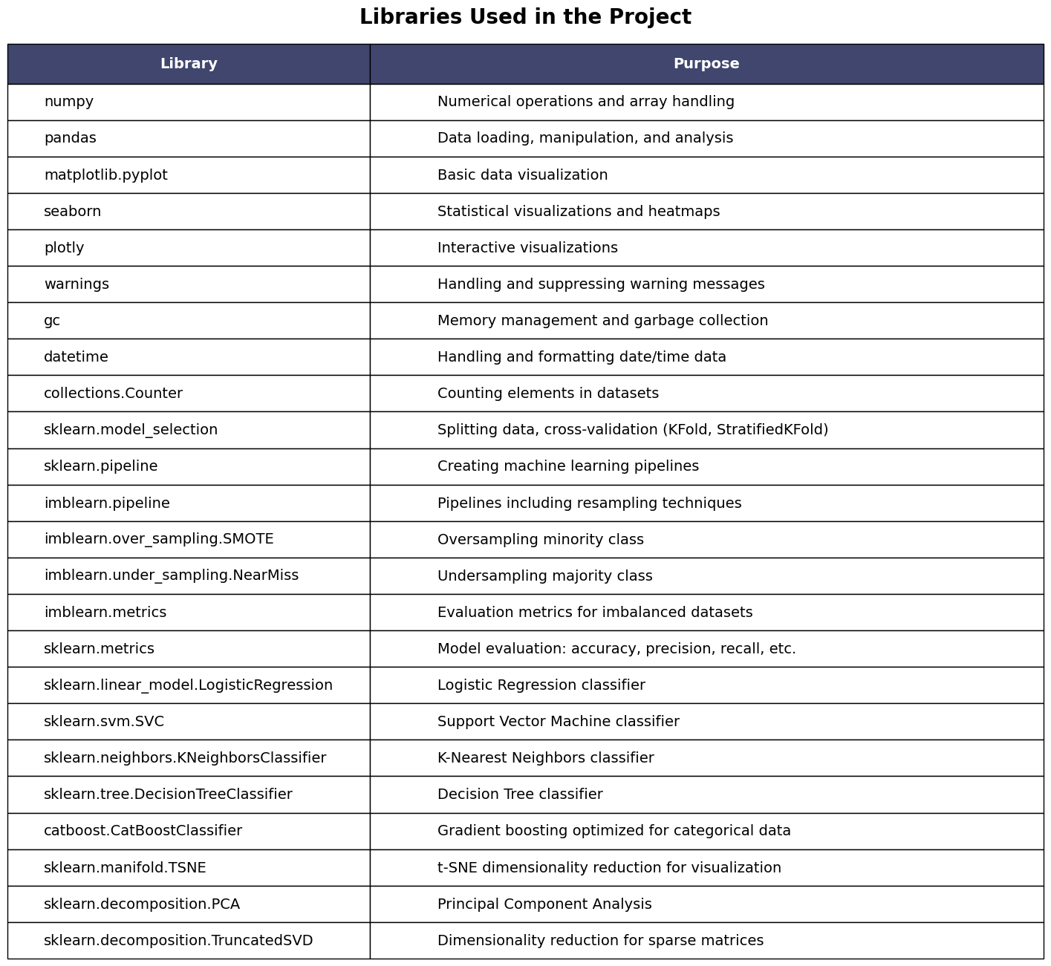
Tools & Libraries Used
Ismayil Aliyev

Slide 7
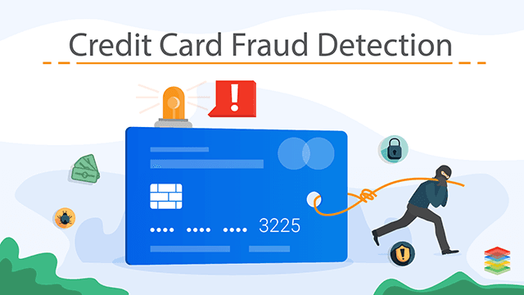
Understanding the Data and Preparation
The datasets contains transactions made by credit cards in September 2013 by european cardholders. This dataset presents transactions that occurred in two days, where we have 492 frauds out of 284,807 transactions.
Due to confidentiality issues, there are not provided the original features and more background information about the data.
Ismayil Aliyev

Slide 8
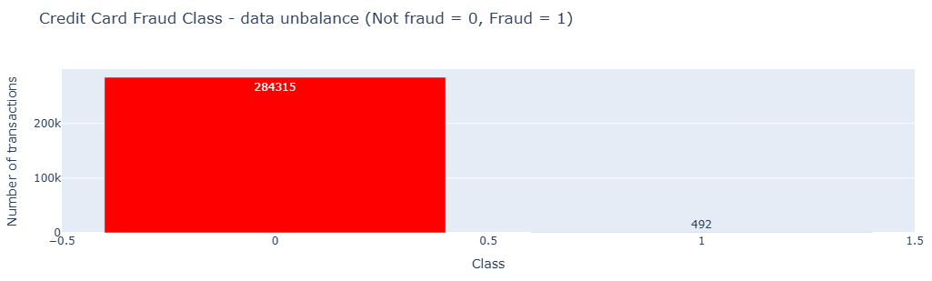
Understanding the Data and Preparation
Summary:
The transaction amount is relatively small. The mean of all the mounts made is approximately USD 88.
There are no "Null" values, so we don't have to work on ways to replace values.
Most of the transactions were Non-Fraud (99.83%) of the time, while Fraud transactions occurs (017%) of the time in the dataset.
Feature Technicalities:
PCA Transformation: The description of the data says that all the features went through a PCA transformation (Dimensionality Reduction technique).
Scaling: All values have been scaled before PCA Transformation.
Ismayil Aliyev

Slide 9
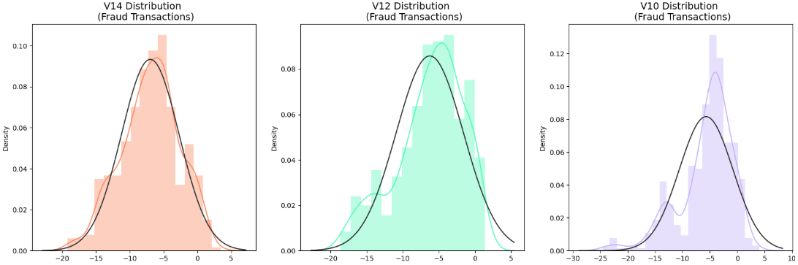
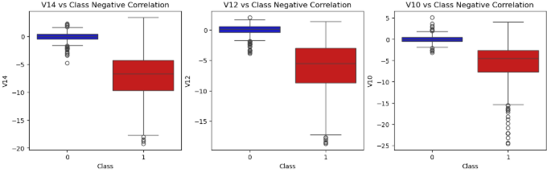
Understanding the Data and Preparation
After some analysis outliers detected in various features and we will eliminate them before EDA and applying algorithms
Ismayil Aliyev

Slide 10
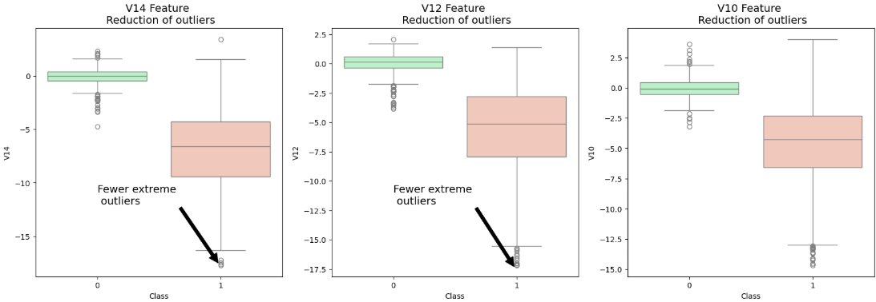
Understanding the Data and Preparation
Feature V14 Outliers for Fraud Cases: 4
Number of Instances after outlier removal: 972
Feature V12 Outliers for Fraud Cases: 4
Number of Instances after outlier removal: 976
Feature V10 Outliers for Fraud Cases: 27
Number of Instances after outlier removal: 948
Ismayil Aliyev

Slide 11
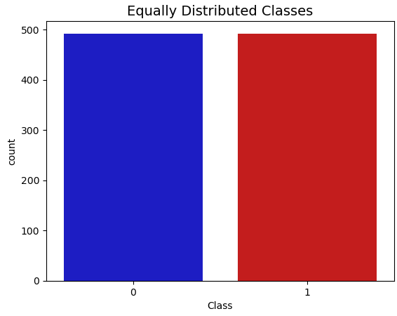
Random Under sampling and Over sampling
Random Under sampling
Random under sampling is a technique used to handle imbalanced datasets by reducing the number of majority class samples. It randomly removes instances from the majority class to create a more balanced distribution with the minority class.
Random Oversampling (or SMOTE Oversampling)
Random oversampling involves increasing the number of minority class samples to balance the dataset. This can be done by duplicating existing minority instances or, in the case of SMOTE (Synthetic Minority Over-sampling Technique), by generating new synthetic examples based on existing ones.
Ismayil Aliyev

Slide 12
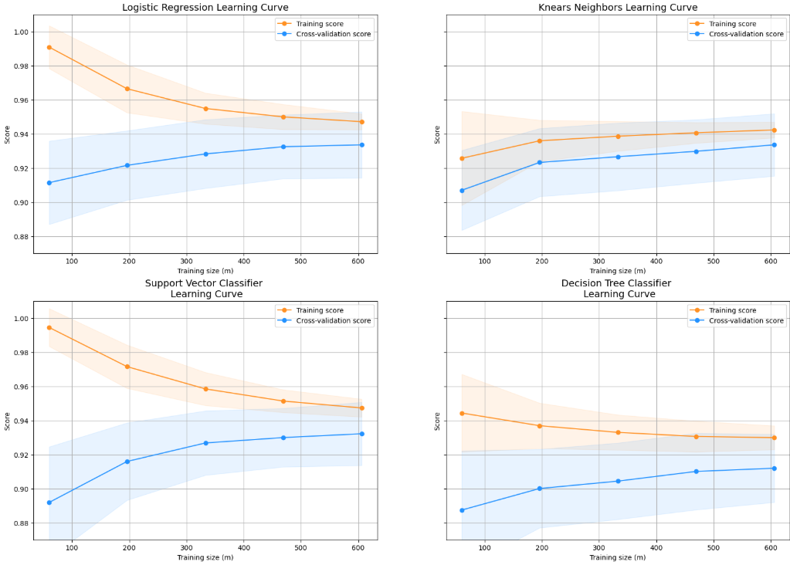
Model Building and Evaluation
Ismayil Aliyev

Slide 13
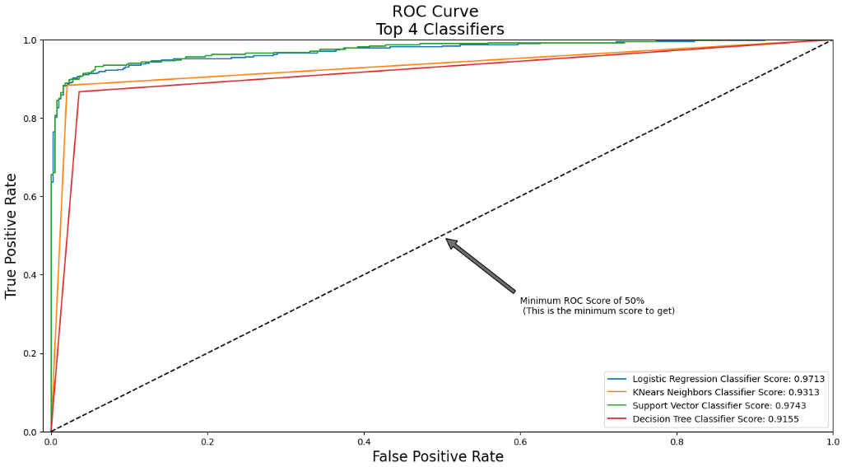
Model Building and Evaluation
Among the models, the Support Vector Classifier has the highest area under the curve (0.9743), meaning it performed best at distinguishing between classes. Logistic Regression follows closely with a score of 0.9713, showing strong predictive power as well. K-Nearest Neighbors also performed well (0.9313), though slightly below the top two. The Decision Tree classifier scored the lowest (0.9155), but still well above the 50% baseline shown by the diagonal line.
Ismayil Aliyev

Slide 14
Model Building and Evaluation
Model | TP | TN | FP | FN
Logistic Regression | 85 | 100 | 0 | 4
K-Nearest Neighbors | 79 | 99 | 2 | 10
Support Vector Machines | 82 | 100 | 0 | 7
Decision Tree | 80 | 96 | 5 | 9
Ismayil Aliyev

Slide 15

Model Building and Evaluation
This table compares the performance of two resampling strategies for handling class imbalance. SMOTE, which creates new synthetic examples of the minority class, slightly outperforms Random Under Sampling, which reduces the size of the majority class.
The higher score from SMOTE (0.9862 vs. 0.9789) suggests that keeping more original data and enriching it with synthetic examples helped the model learn patterns more effectively. In contrast, under sampling might have led to some information loss, which slightly affected performance. Overall, over sampling appears to offer a better balance between precision and data retention.
Ismayil Aliyev

Slide 16
Conclusion
In conclusion, this project explored various classifiers and resampling techniques to address the challenge of class imbalance, which is common in many real-world problems such as fraud detection, medical diagnosis, and spam filtering.
The results showed that models like Support Vector Machines and Logistic Regression performed best, especially when paired with oversampling using SMOTE. While these methods improved predictive accuracy, limitations remain — such as potential overfitting with synthetic data and the need for careful tuning when applied to more complex or noisy datasets.
Despite these challenges, this approach provides a practical framework for improving classification in imbalanced datasets. It can be adapted and applied to real-world scenarios where correctly identifying rare but critical cases is essential.
Ismayil Aliyev

Slide 17
References
References
Hands on Machine Learning with Scikit-Learn & TensorFlow by Aurélien Géron (O'Reilly). CopyRight 2017 Aurélien Géron
Machine Learning - Over-& Undersampling - Python/ Scikit/ Scikit-Imblearn by Coding-Maniac
auprc, 5-fold c-v, and resampling methods by Jeremy Lane (Kaggle Notebook)
Credit Card Fraud Detection Database, Anonymized credit card transactions labeled as fraudulent or genuine, https://www.kaggle.com/mlg-ulb/creditcardfraud
Principal Component Analysis, Wikipedia Page, https://en.wikipedia.org/wiki/Principal_component_analysis
RandomForrestClassifier, http://scikit-learn.org/stable/modules/generated/sklearn.ensemble.RandomForestClassifier.html
ROC-AUC characteristic, https://en.wikipedia.org/wiki/Receiver_operating_characteristic#Area_under_the_curve
AdaBoostClassifier, http://scikit-learn.org/stable/modules/generated/sklearn.ensemble.AdaBoostClassifier.html
CatBoostClassifier, https://tech.yandex.com/catboost/doc/dg/concepts/python-reference_catboostclassifier-docpage/
XGBoost Python API Reference, http://xgboost.readthedocs.io/en/latest/python/python_api.html
LightGBM Python implementation, https://github.com/Microsoft/LightGBM/tree/master/python-package
LightGBM algorithm, https://www.microsoft.com/en-us/research/wp-content/uploads/2017/11/lightgbm.pdf
DEALING WITH IMBALANCED DATA: UNDERSAMPLING, OVERSAMPLING AND PROPER CROSS-VALIDATION
SMOTE explained for noobs
Machine Learning - Over-& Undersampling - Python/ Scikit/ Scikit-Imblearn
Ismayil Aliyev

Slide 18
Thanks for attention!

